Slide 1
Regression

Slide 2


Regression
Predicting continuous numerical values.
Algorithms : Multi-Linear regression, Polynomial Regression, Decision Trees, Random Forest, XGBoost.
Examples :
House Price Prediction
Drink Quality Prediction
Air Quality Prediction
Income Prediction
Dependent variable
Independent variable (x)
Sensitivity: Internal

Slide 3
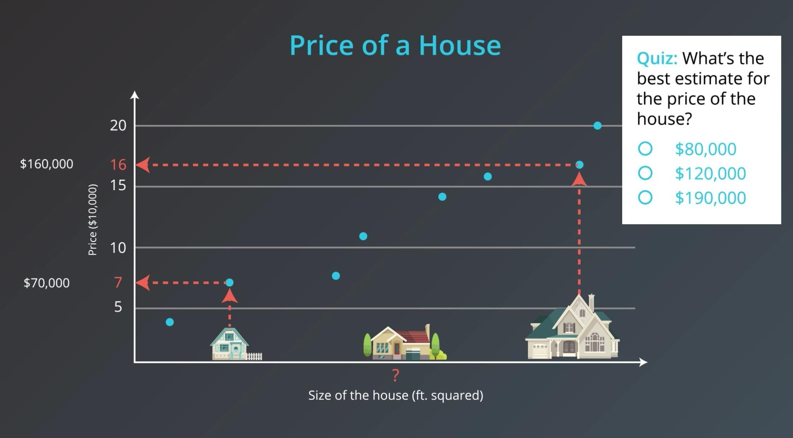
Regression

Slide 4
Linear Regression – Fitting Line
Come Closer

Slide 5
Linear Regression – Fitting Line
Come Closer
Come Closer
Come Closer
Come Closer
Come Closer

Slide 6
Linear Regression – Fitting Line
Come Closer
Come Closer
Come Closer
Come Closer
Come Closer

Slide 7
Linear Regression – Fitting Line

Slide 8
Linear Regression – Fitting Line

Slide 9

Linear Regression – Fitting Line

Slide 10
Linear Regression – Moving Line
ŷ = w₁x + w₂
w₁
w₂
w₁: Slope
w₂: y-intercept

Slide 11
Linear Regression – Moving Line
ŷ = w₁x + w₂
w₁
w₂
w₁: Slope
w₂: y-intercept

Slide 12
Linear Regression – Moving Line
ŷ = w₁x + w₂
w₁
w₂
w₁: Slope
w₂: y-intercept

Slide 13
Linear Regression – Moving Line
ŷ = w₁x + w₂
w₁
w₂
w₁: Slope
w₂: y-intercept

Slide 14
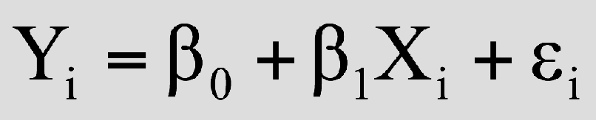
Linear Regression
Linear Regression fits a straight line through data.
Y
Observed Value of Y for X_{i}
ε_{i}
Slope = β₁
Predicted Value of Y for X_{i}
Error for this X_{i} value
Intercept = β₀
X_{i}
X
Same Equation
y_{i} = w₁x_{i} + w₂ + ε_{i}

Slide 15
Error Functions
Absolute Error
Squared Error

Slide 16
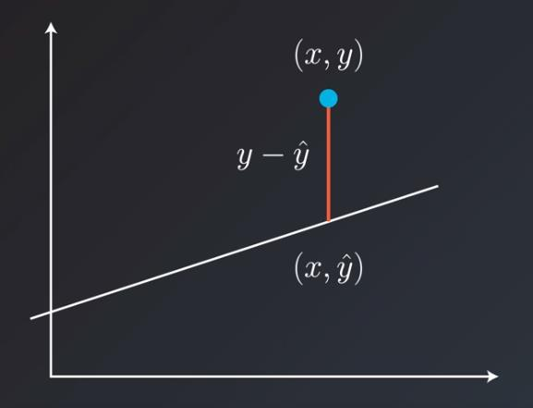
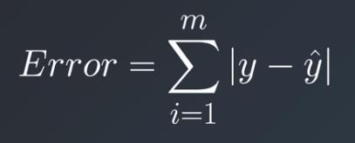
Absolute Error

Slide 17
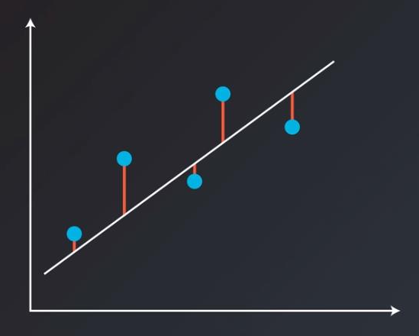
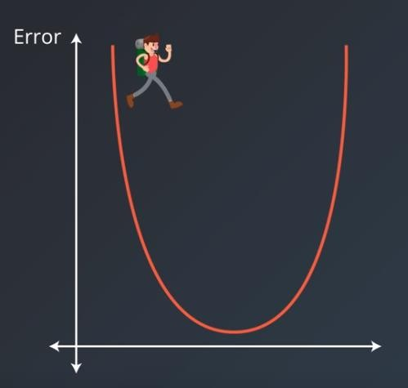
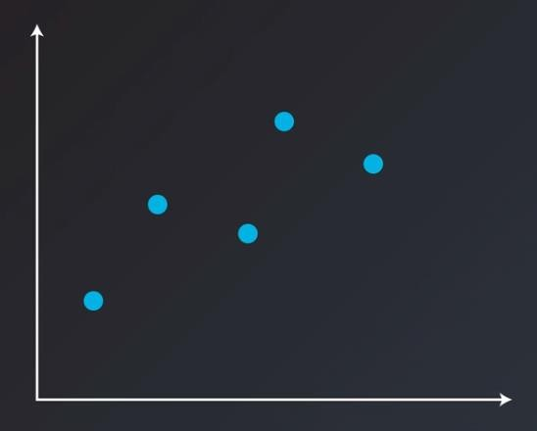
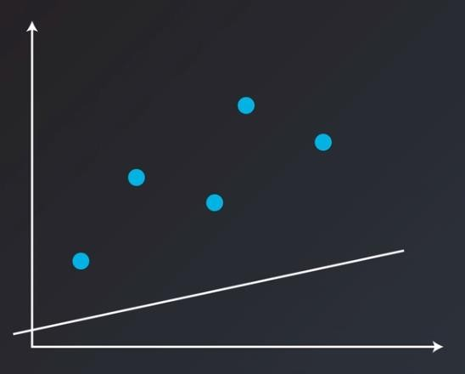
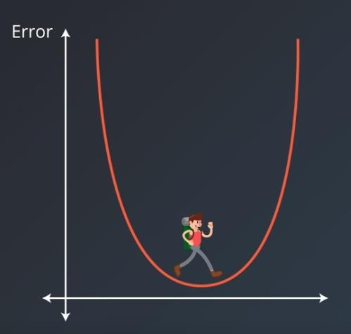
Absolute Error

Slide 18
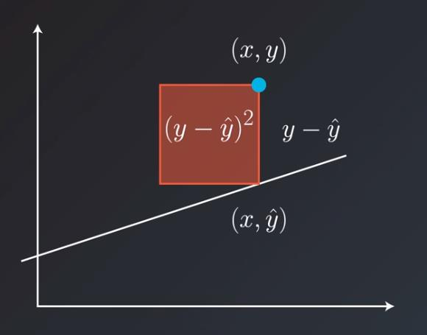
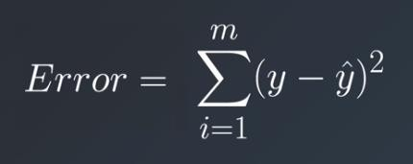
Square Error

Slide 19
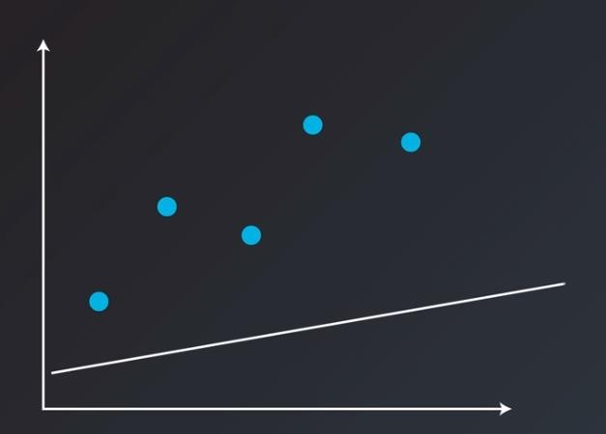
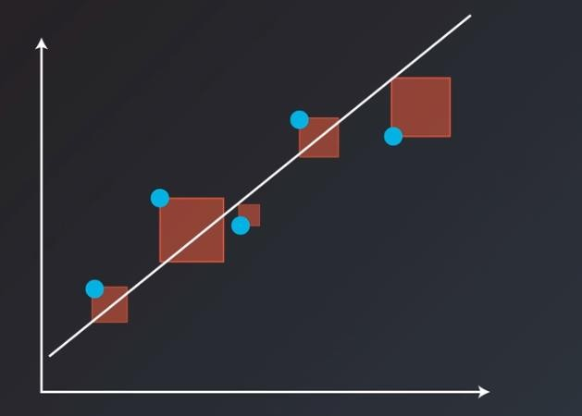
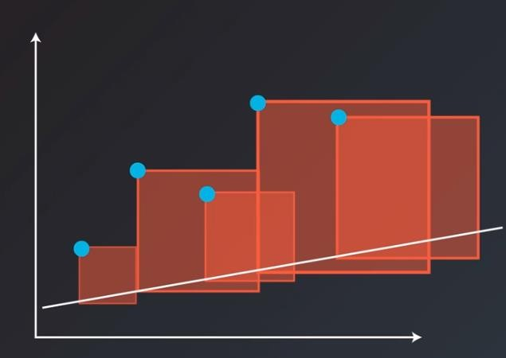
Square Error

Slide 20
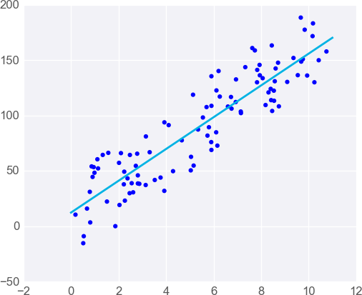
Multi-Linear Regression
When you have one predictor variable, the equation of the line is

Slide 21
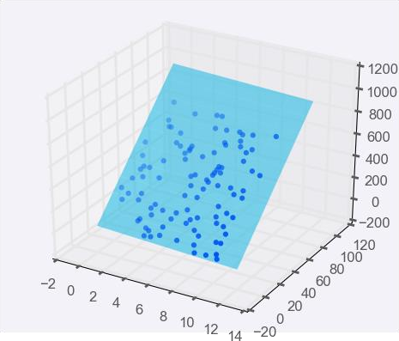
Multi-Linear Regression
Adding a predictor variable to go to two predictor variables means that the predicting equation is:

Slide 22
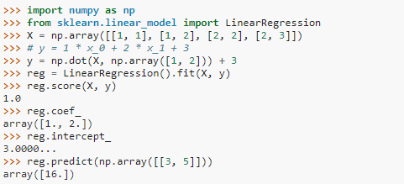
Linear Regression in sklearn
https://scikit- learn.org/stable/modules/generated/sklearn.linear_model.LinearRegression.html

Slide 23
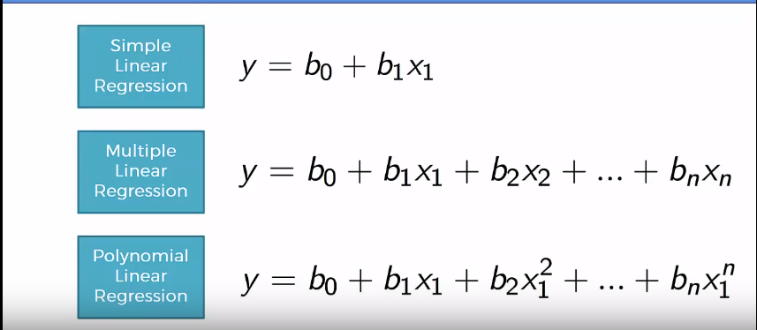
Linear VS Multi-Linear VS Polynomial Regression

Slide 24
R2 Score
SSE
Sum of Squared Error
SSR
Sum of Squared Regression
Dependent Variable (Y)
Dependent Variable (Y)
Samples Mean: y
Independent variable (X)
Independent Variable (X)

Slide 25
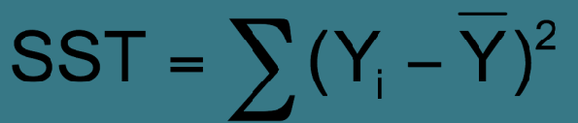
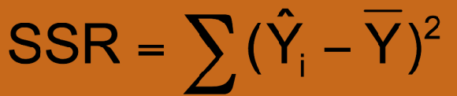

R2 Score
Total Variation is given by Total Sum of Square (SST).
Total Variation
Explained Variation
Unexplained Variation

Slide 26


R2 Score
R-squared is a statistical measure of how close the data are to the fitted regression line.
It is the percentage of the response variable variation that is explained by a linear model.
R-squared is always between 0 and 100%:
0% indicates that the model explains none of the variability of the response data around its mean.
100% indicates that the model explains all the variability of the response data around its mean.
_{R}2 ₌

Slide 27
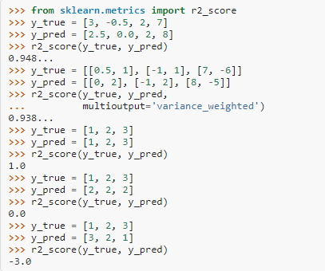
R2 Score in sklearn
https://scikit- learn.org/stable/modules/generate d/sklearn.metrics.r2_score.html

Slide 28
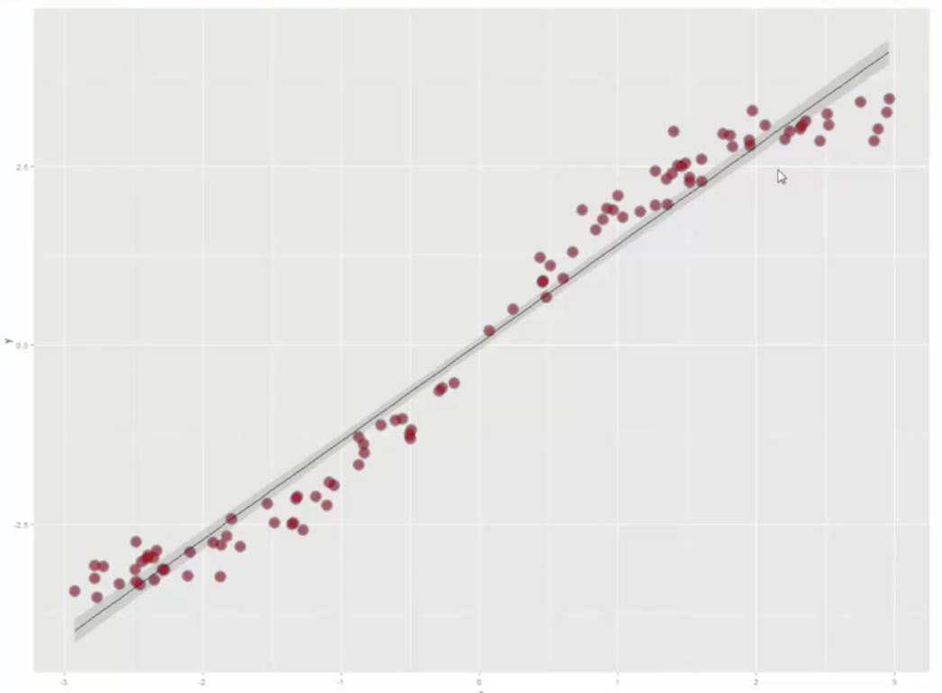
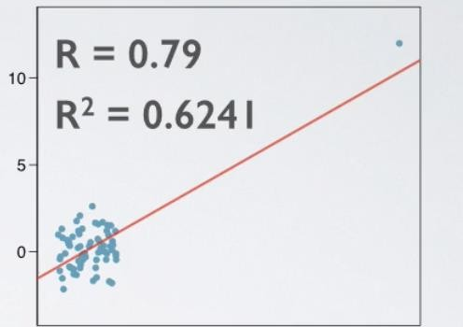

Limitations of R²
You cannot use R-squared to determine whether the coefficient estimates and predictions are biased, which is why you must assess the residual plots.
R-squared does not indicate if a regression model provides an adequate fit to your data.

Slide 29
Limitations of R²
Every time you add a predictor to a model, the R-squared increases, even if due to chance alone. It never decreases. Consequently, a model with more terms may appear to have a better fit simply because it has more terms.
1.00
0.75
0.50
0.25
_{R}2
1
2
3 4 5 6 7 8 9 10
No of features

Slide 30
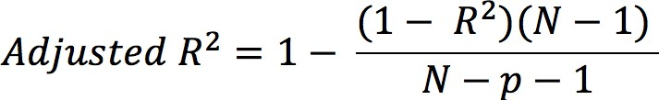
Adjusted R²
It is a modified version of R-squared that has been adjusted for the number of predictors in the model.
It increases only if the new term improves the model more than would be expected by chance.
It decreases when a predictor improves the model by less than expected by chance.
It can be negative, but it’s usually not. It is always lower than the R-squared.
N: is the number of points in your data sample. p: is the number of predictors

Slide 31
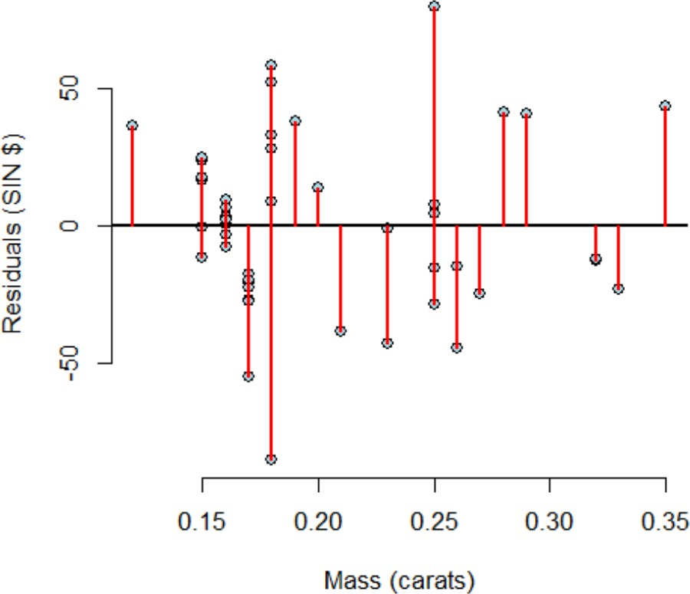
Residuals Plots
Only Residuals plotted against Predictor.
There shouldn’t be any patterns in Residual Plots!

Slide 32
Residuals Plots
Regression fit of a data. What patterns are there?

Slide 33
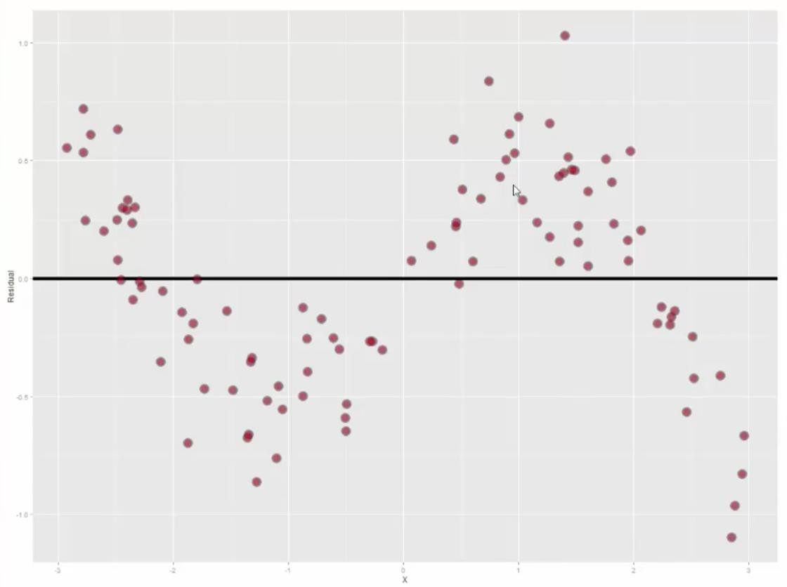
Residuals Plots
Residual Plot. What does it tell?

Slide 34
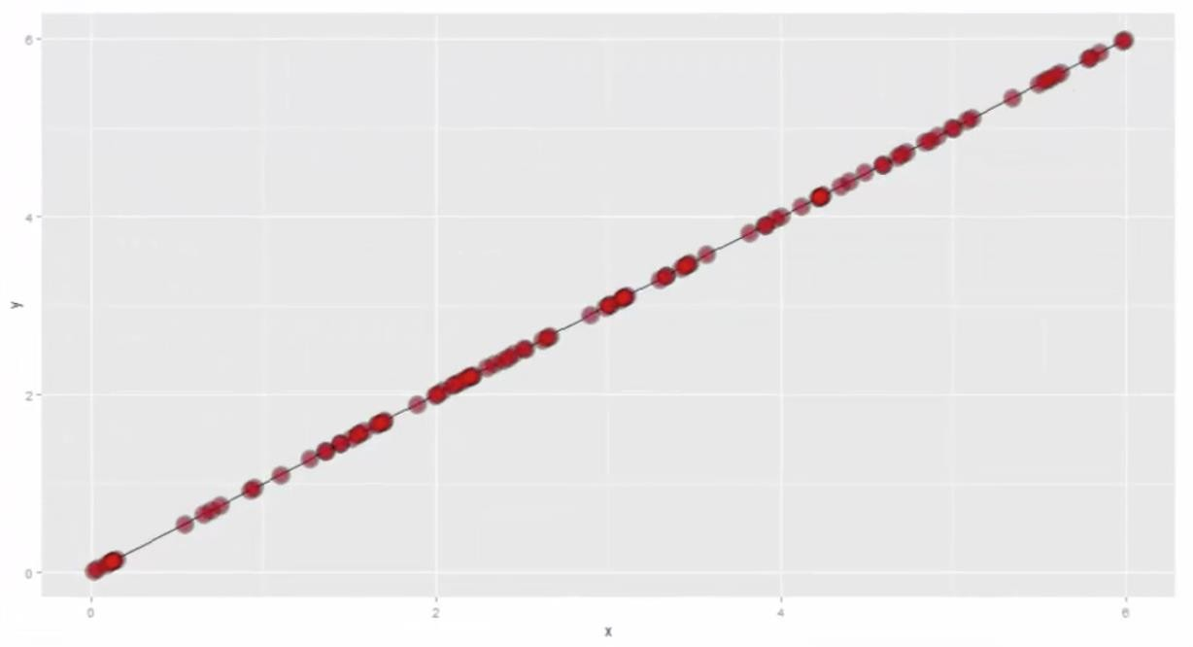
Residuals Plots
Another Regression fit. Sounds perfect?

Slide 35
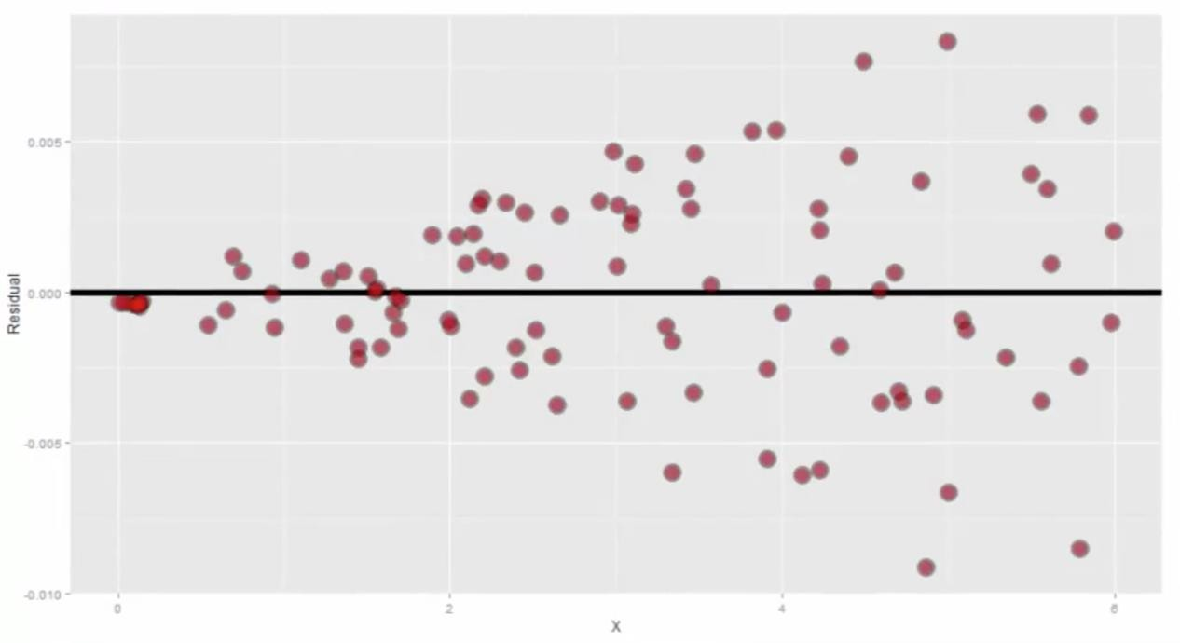
Residuals Plots
Residual Plot tells a different story!

Slide 36
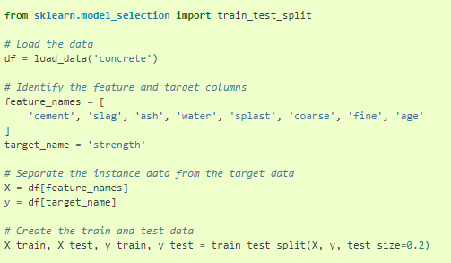
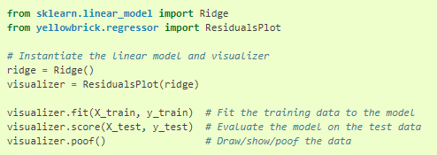
Residual Plots in yellowbricks
https://www.scikit- yb.org/en/latest/api/regr essor/residuals.html

Slide 37
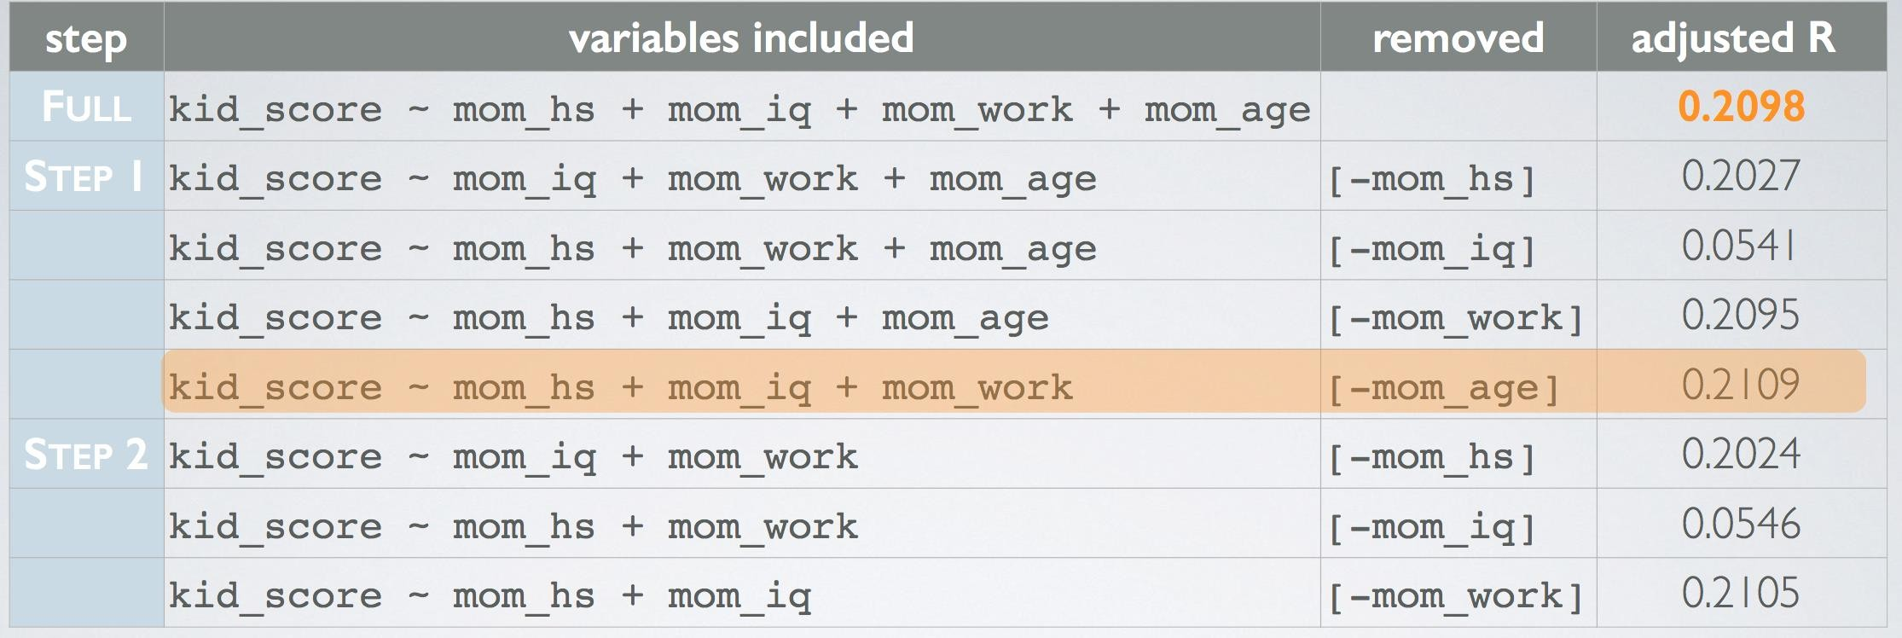

Multivariable Regression (Model Selection)
Recursive Feature Elimination with Scikit Learn
_{R}2
https://scikit-learn.org/stable/modules/generated/sklearn.feature_selection.RFE.html

Slide 38
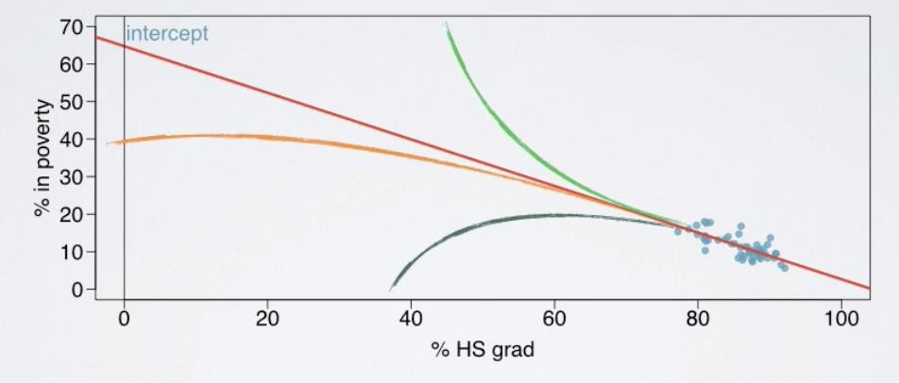
Linear Regression - Limitations
Applying a model estimate to values outside the realm of the original data is called Extrapolation.
Linear Regression is not used for extrapolation

Slide 39
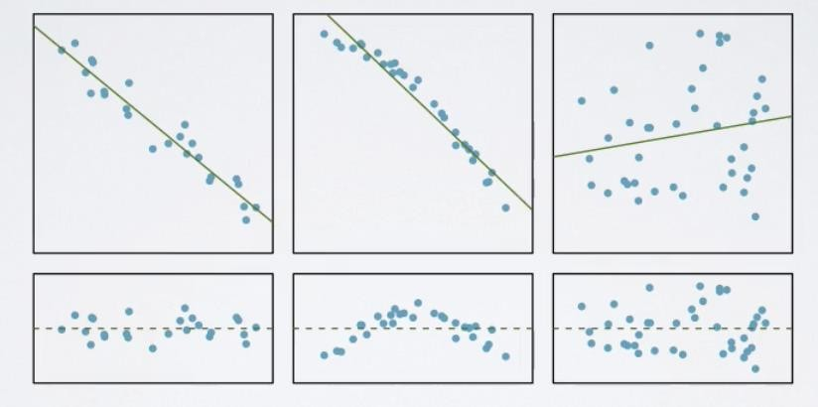
Linear Regression - Limitations
Relationship between Response and Explanatory Variable must be linear.
Check using Scatterplot or Residual Plot.

Slide 40
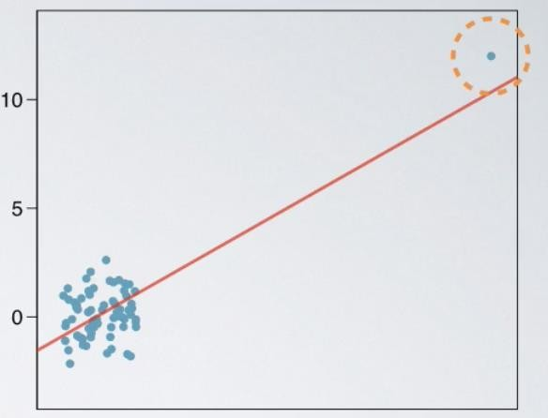
Linear Regression - Limitations
Remove the Outlier to see the effect.
In this case, the Outlier makes it appear as if there is a linear relation when actually there is not.

Slide 41
Linear Regression (Outliers)
There are two types of Outliers:
Leverage Points: Outliers that fall horizontally away from centre of the cloud but don’t influence the slop of regression line.
Influential Points: Outliers that actually influence the slop of regression line. To check, remove this point and see the effect on regression line.

Slide 42
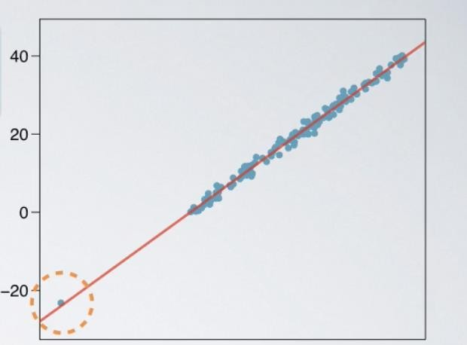
Linear Regression (Outliers)
What type of Outlier is this?

Slide 43
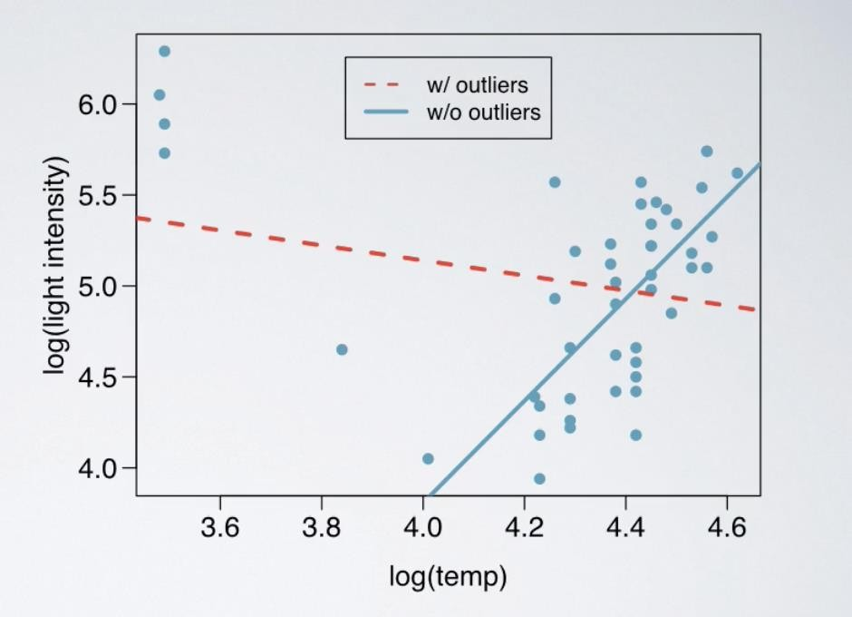
Linear Regression (Outliers)

Slide 44
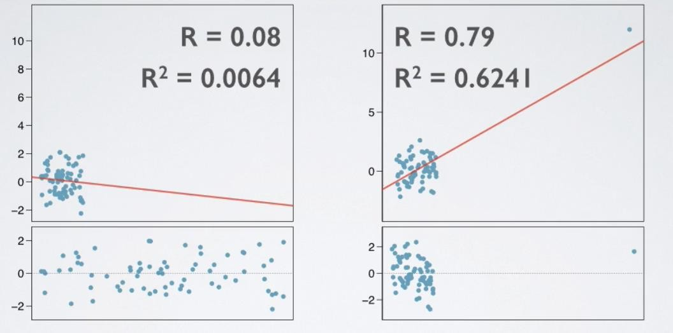
Linear Regression (Outliers)

Slide 45
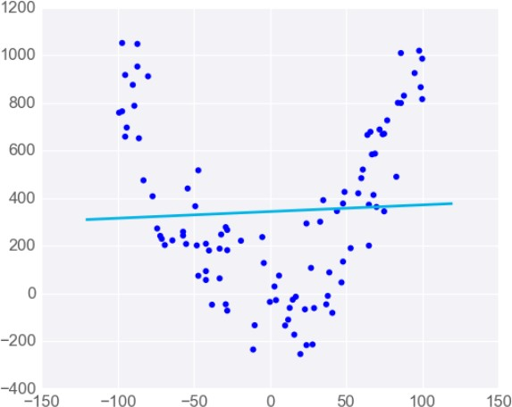
Polynomial Regression
Linear Regression Works Best When the Data is Linear

Slide 46
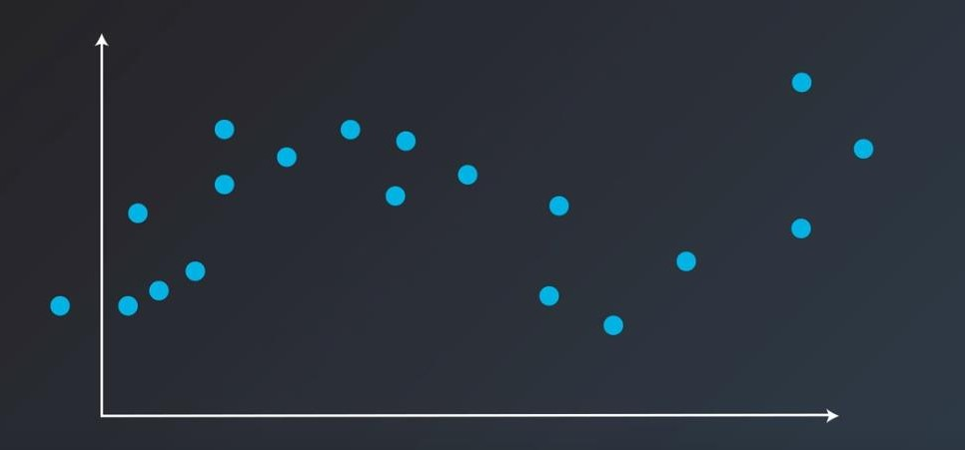
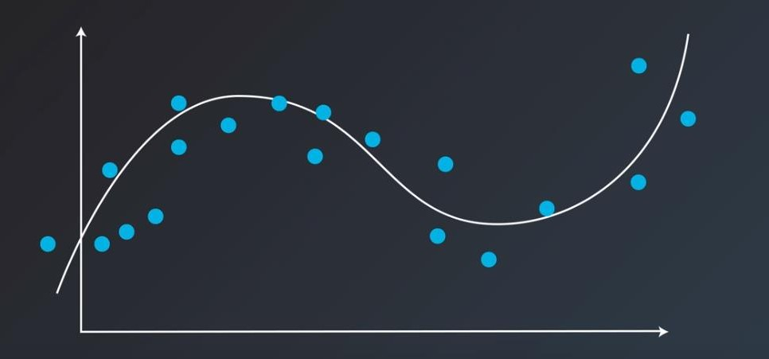


Polynomial Regression

Slide 47


Model Selection
Simple Problem
Complex Solution

Slide 48


Model Selection
Complex Problem
Simple Solution

Slide 49
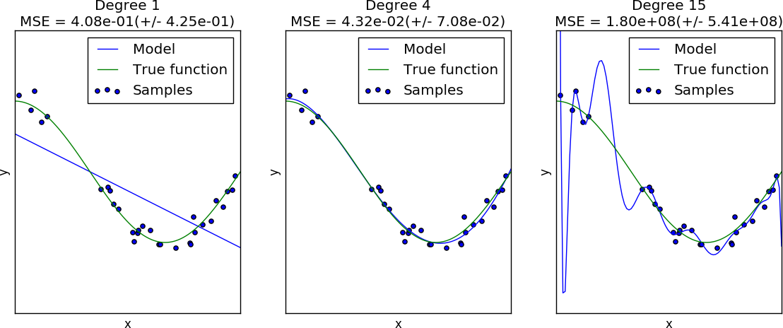




Under-fitting & Over-fitting

Slide 50
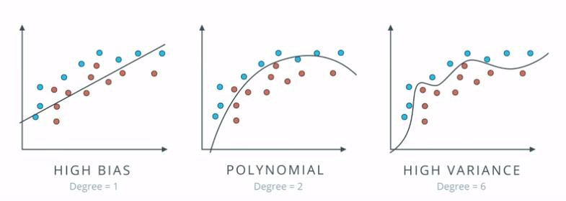
Model Complexity

Slide 51
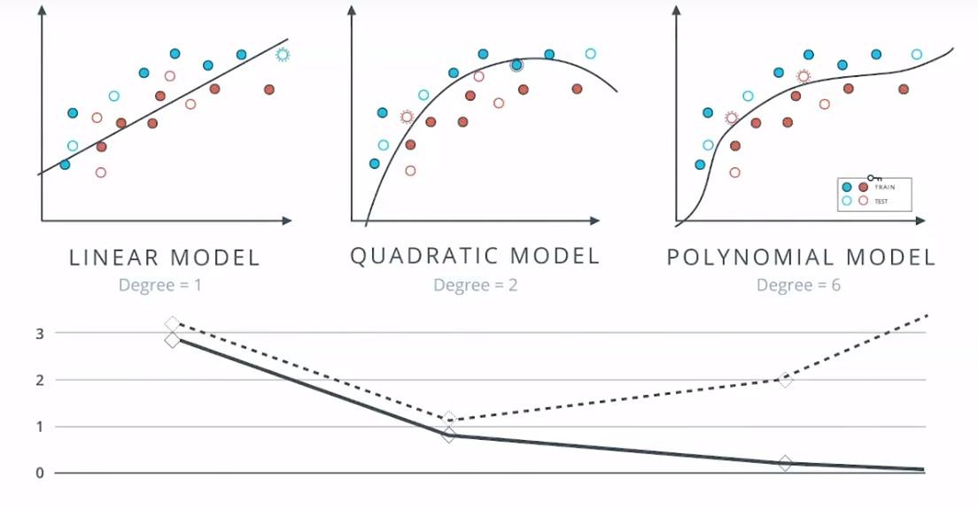
Model Complexity
E R R O R

